Slide 1



SORTING VISUALIZER
Pham Quang Hieu 20194432
Nguyen Van Thanh Tung 20190090
Nguyen Vu Thien Trang 20194459
Merge Sort
Selection Sort
Shell Sort

Slide 2
PROBLEM
Selection Sort
Merge Sort
Shell Sort
Design
TARGET
Explaining and visualizing different sorting algorithms
Design an UI for the problem with different features
Help users have a better insight about how algorithms work

Slide 3
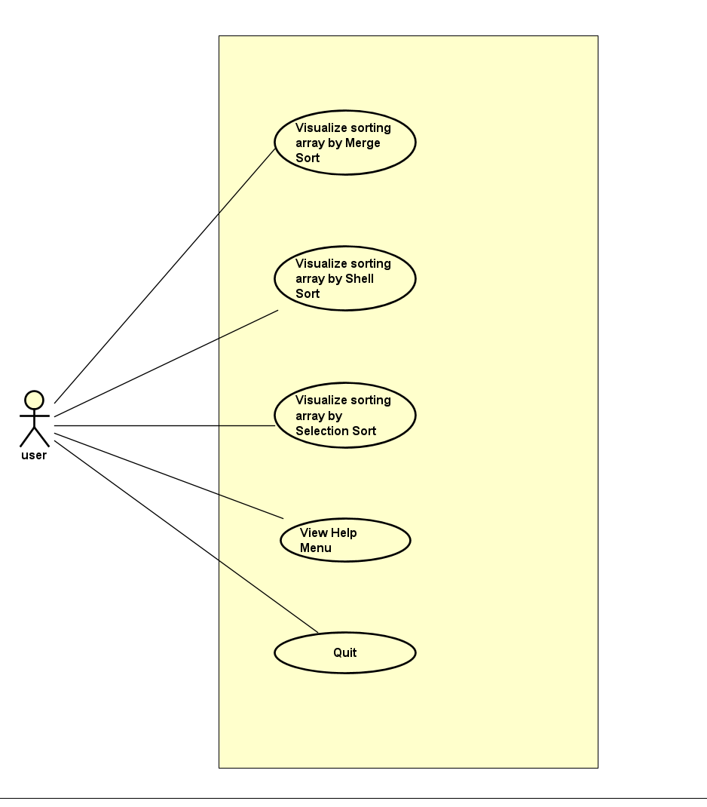
SOLUTION
USE CASE DIAGRAM
Users can start visualizing by selecting a sort type
Take all user command from the GUI
Notice the user if there is anything wrong with his input
Run the designated algorithm
Run/Reset the visualization based on user command.
Users can view the help menu
Users can quit the program
Jupiter is a gas giant and the biggest planet in the Solar System

Slide 4
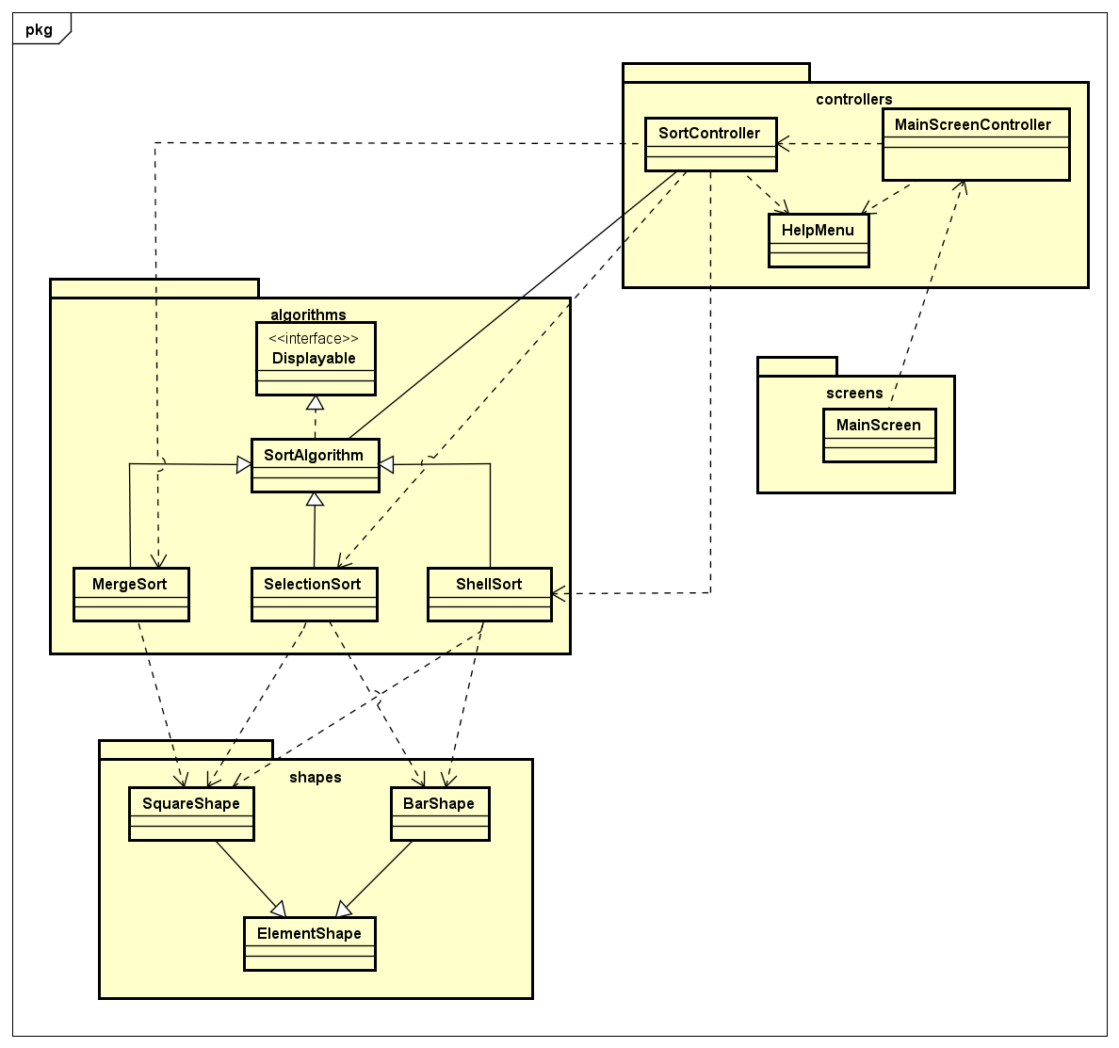
CLASS DIAGRAM
Package “algorithms”: store 3 sorting algorithms for visualizing, and an abstract class SortAlgorithm to store common operations, attributes
Package “controllers”: store all the screen controllers
Package “screens”: store the main screen class of the application
Package “shapes”: store the abstract class “ElementShape” and 2 derived shapes, namely SquareShape and BarShape.

Slide 5
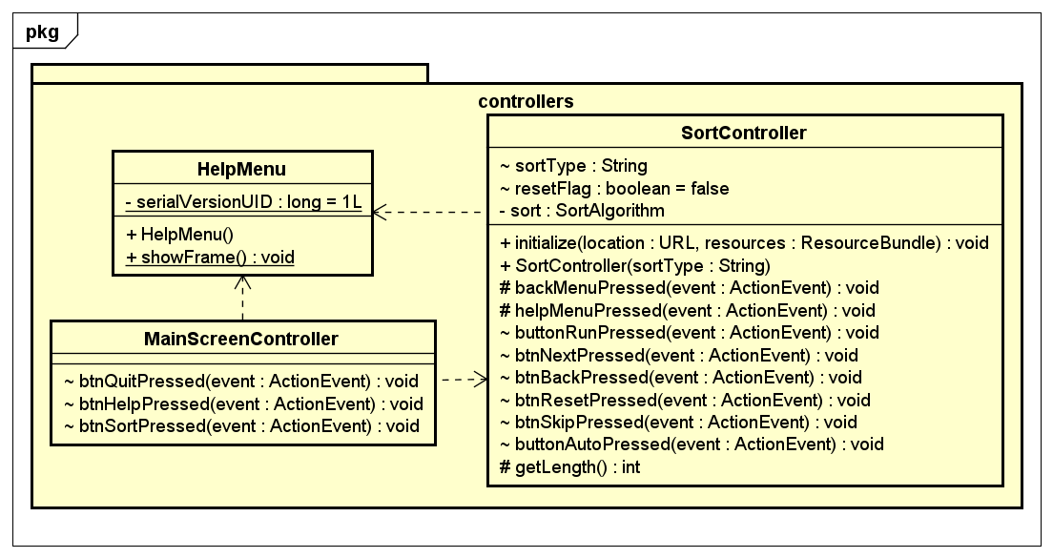

Slide 6
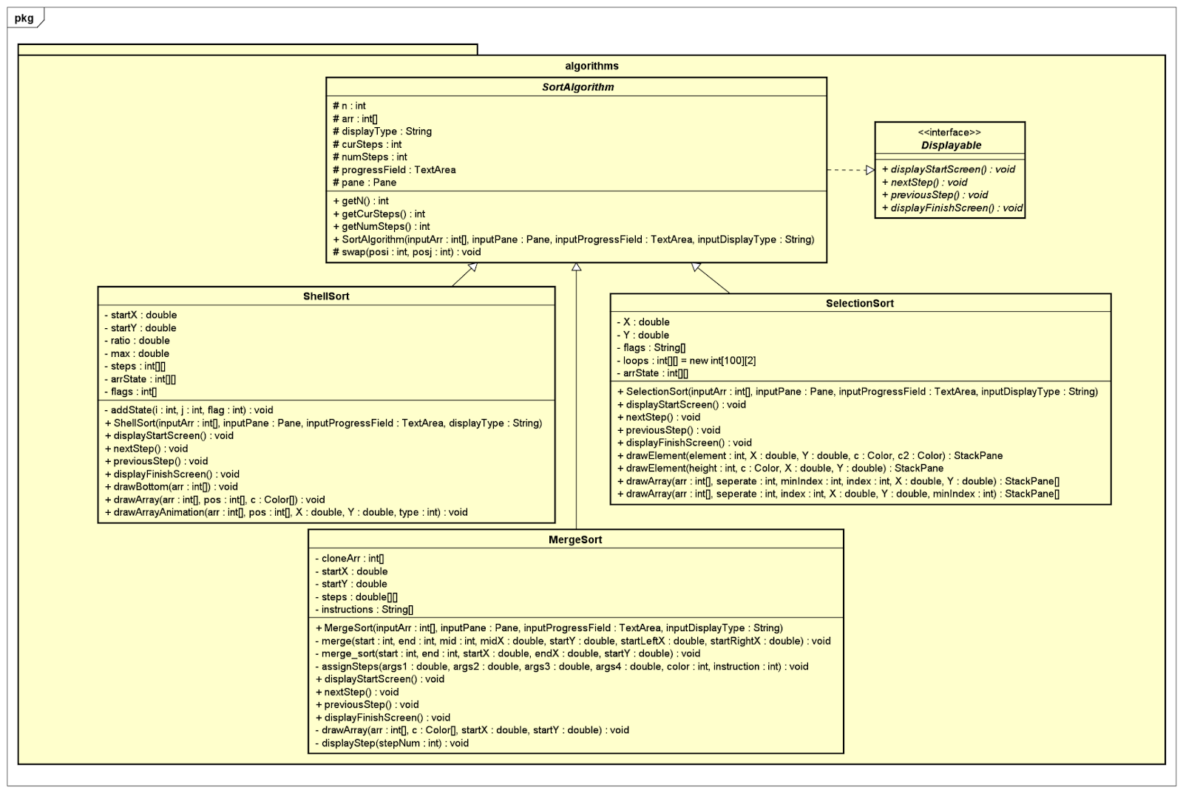

Slide 7
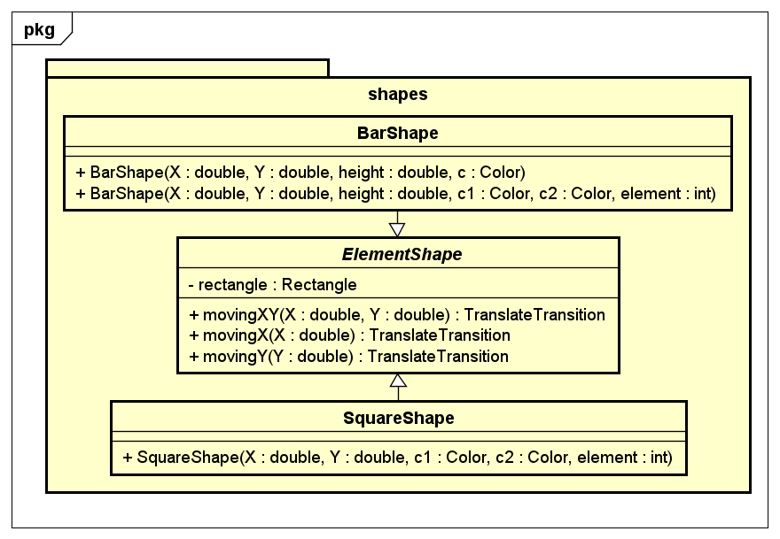

Slide 8
OOP TECHNIQUES
Inheritance
Polymorphism
In package algorithms: three sort types inherit from SortAlgorithm
In package shapes: two shape type inherit from ElementShape
Method polymorphism: different drawElement and drawArray in SelectionSort method to visualize different shapes
Object polymorphism: All specific sort algorithms are upcasted to the abstract class SortAlgorithm, which implements the interface Displayable

Slide 9
